Slide 1
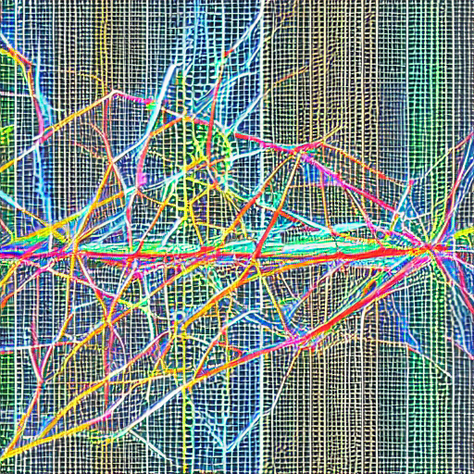
Deep Learning Final Project
Genre Recognition
Lior Breitman 212733257
Talia Seada 211551601
Netanel Levine 312512619

Slide 2



The problem
Given a song we would like to know its genre.
Music genre classification is a challenging task due to the complex and subjective nature of music.
It is an important problem with many practical applications, such as music recommendation systems and playlist generation.

Slide 3
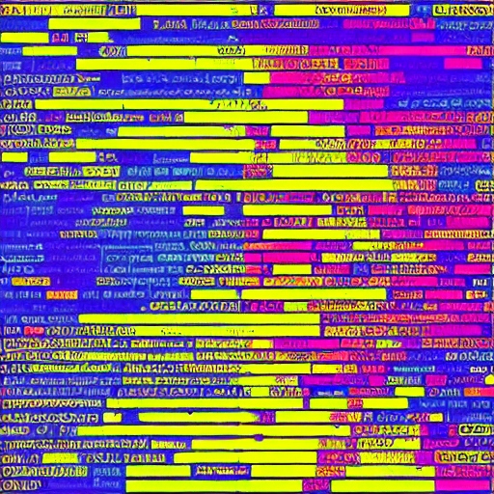
Workflow
Feature extraction from multiple WAV files to a single CSV file
Preprocessing the data: normalizing and balancing
Creating the CNN
Training the model
Evaluating
Fine-tuning

Slide 4
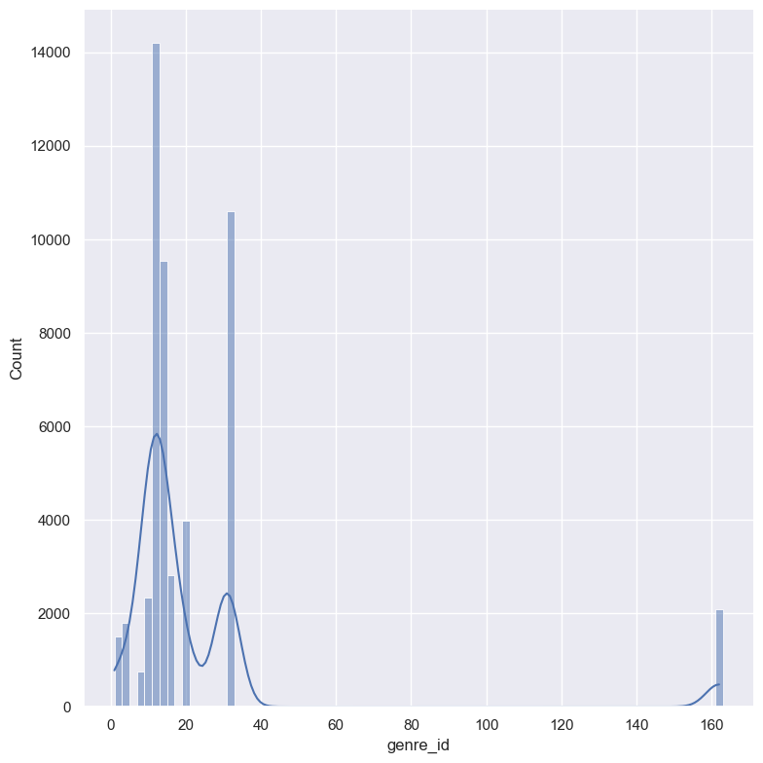
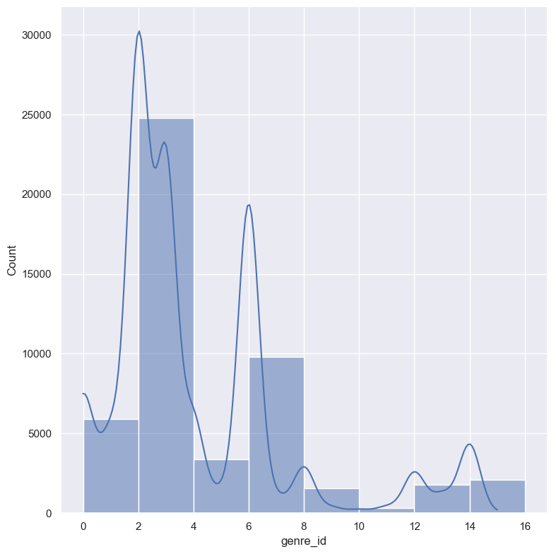
PREPROCESSING THE DATA
Our dataset contains almost 40k samples (30 sec each) of songs distributing among 161 genres.
As part of our preprocessing, we decided to reduce the number of classes by removing the classes that no song belongs to them.
This step left us with 16 genres.
Before Balancing
After Balancing

Slide 5
Normalizing – normalize the data using the mean and the std of our data and the following formula: (data – mean) / std
Remove redundant classes – After performing several networks we've noticed that there are a lot of genres with 0-40 samples in the dataset, so we decided to remove them.
Balancing – We noticed that we have some classes that have much less samples than other classes. We decided to use SMOTE to balance the data.

Slide 6
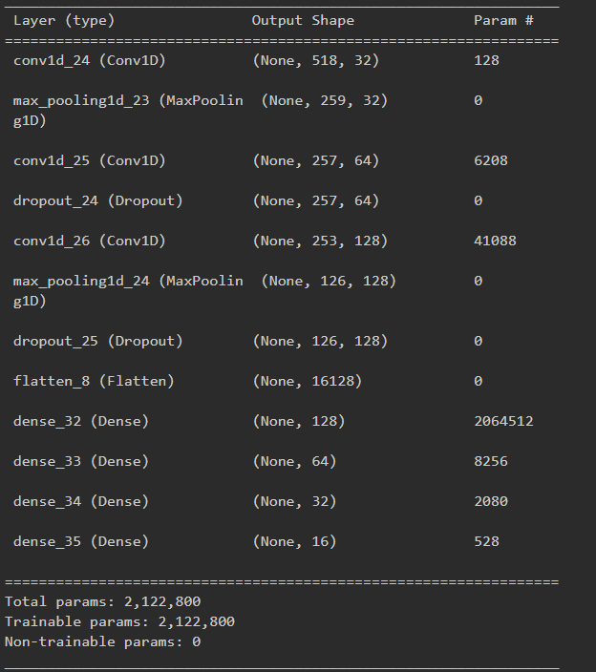
Creating the CNN
We built the model dynamically, meaning we changed the amount and size of layers to try and get the best results.
The overall scheme was the following:
Convolution mixed with Max Pooling
Flatten the data
Fully connected dense layers
Dropout layers
In the last layer, the activation function is Softmax, as we have multiple classes.

Slide 7
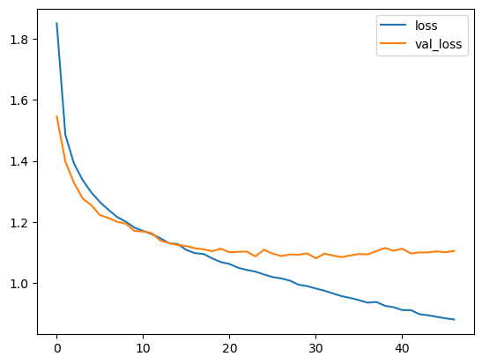
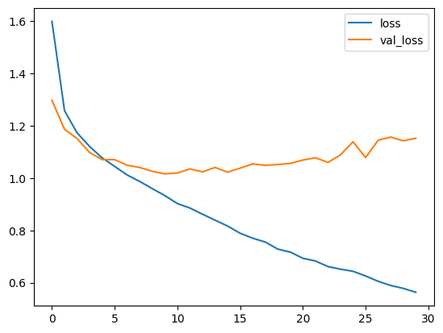
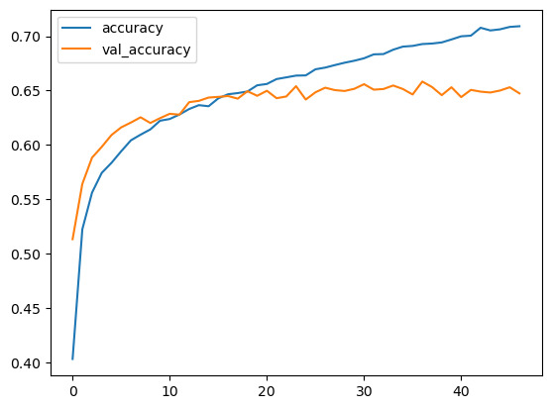
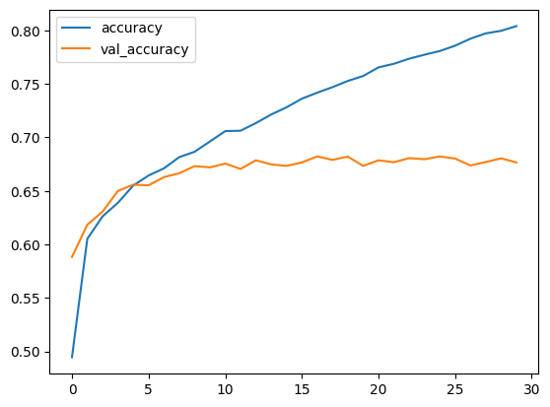
63.1%
67.8%
TRAINING THE
MODEL BEFORE
BALANCING

Slide 8
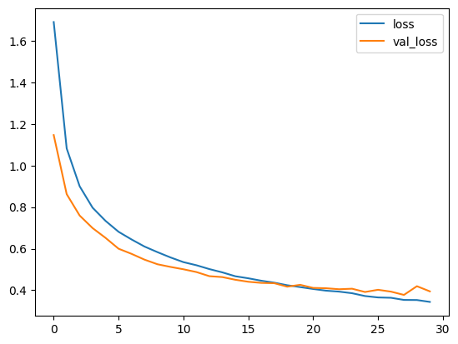
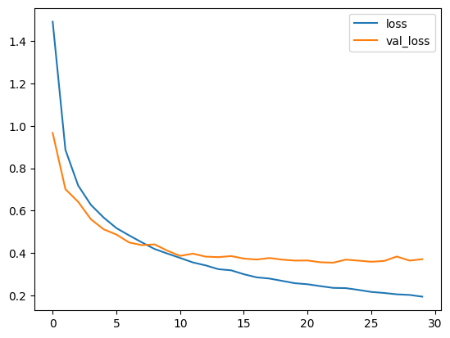
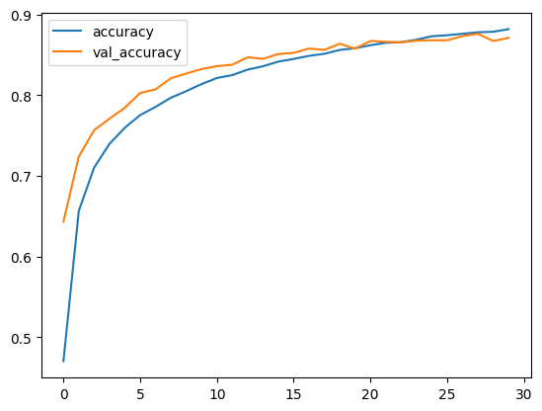
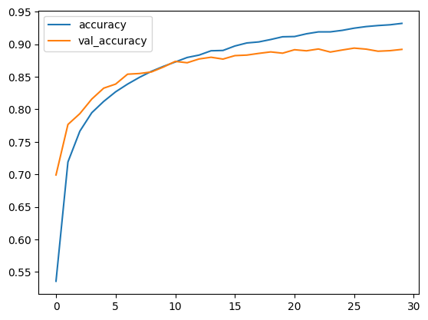
88.3%
89.0%
TRAINING THE
MODEL AFTER
BALANCING

Slide 9
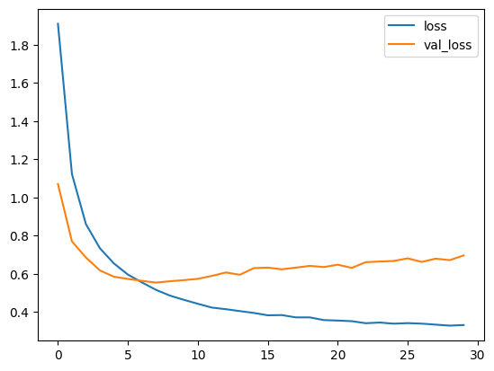
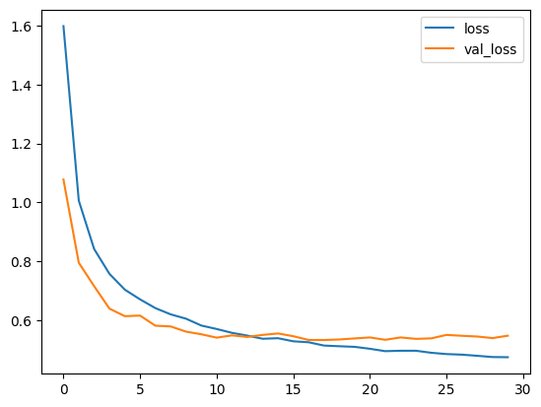
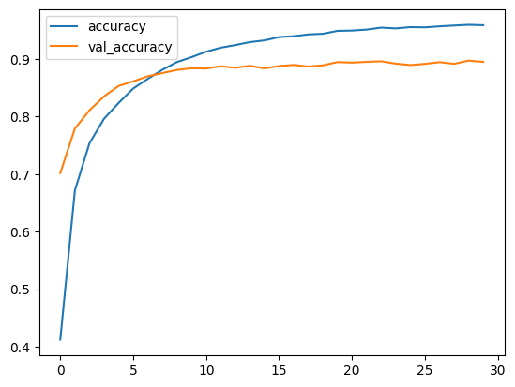
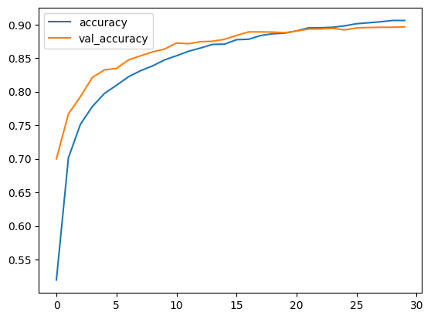
88.9%
89.5%
TRAINING THE
MODEL BALANCED
WITH
REGULARIZATION

Slide 10
Deep learning methods yielded better results than traditional machine learning methods for this complex problem.
Attempted to alter network structure by adding or removing layers during fine-tuning process gave better results.
Observed that imbalanced data greatly impacted results.
Attempted to balance data which significantly improved accuracy of networks.
More data for under-represented genres may improve model performance without the need for manual data balancing.
Regularization helped with the overfitting.
In order to gain better results the data needs to balanced without duplicity and it would help to run and compile it on the cloud where we could scale up the hardware .
Conclusion and Insights

